Slide 1
Challenge 3.3
By: Tan Jia Shun (Alan)
S10198161

Slide 2
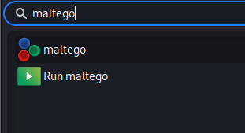
Step 1: run maltego

Slide 3
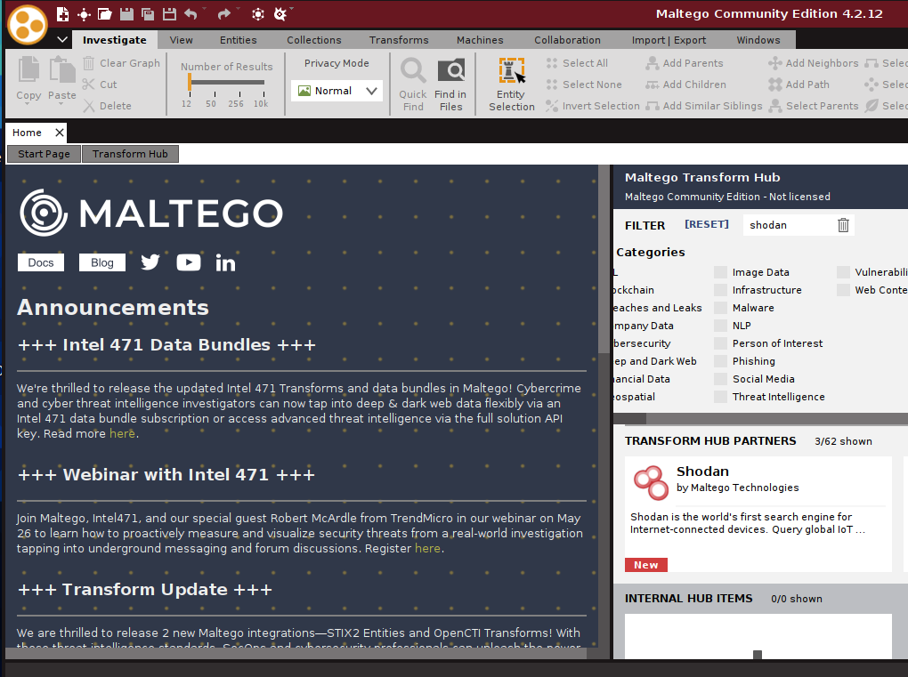
Step 2: search & install Shodan Transform​

Slide 4
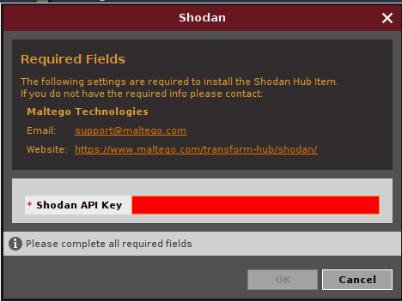
Step 3: key your shodan API key

Slide 5
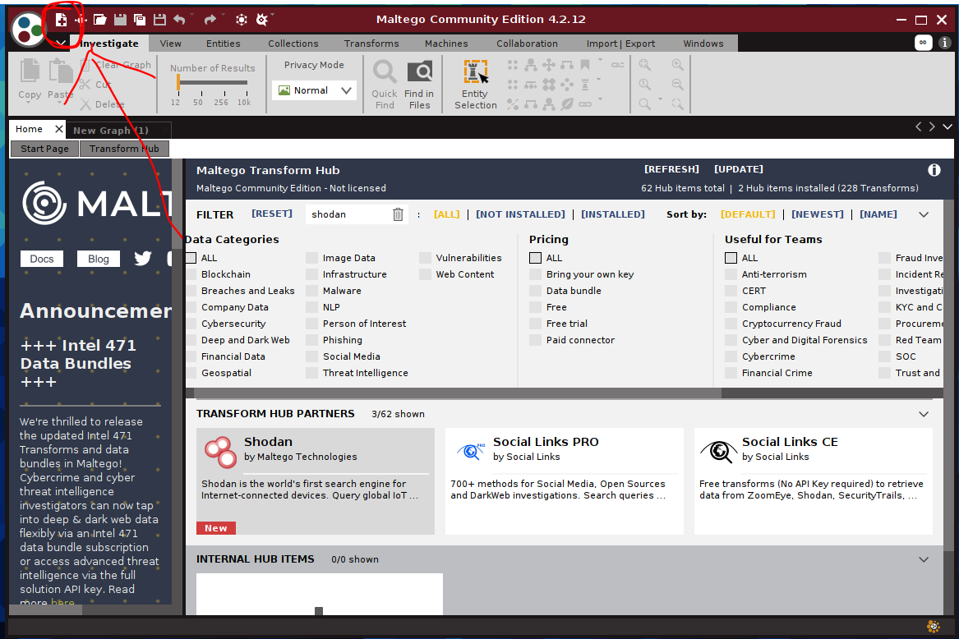
Step 4: Create new graph

Slide 6
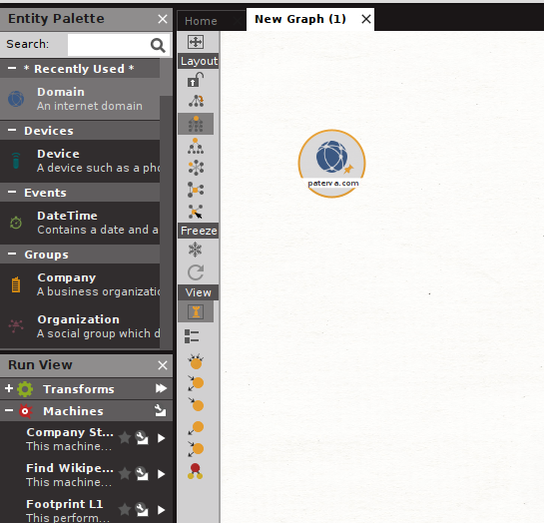
Step 5: Add a domain entity & change the domain to target domain

Slide 7
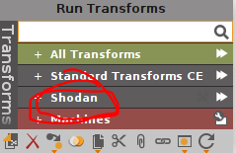
Step 6: Right click to select shodan transform

Slide 8
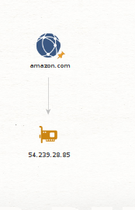
Result

